Slide 1

SMART DOOR LOCK SYSTEM
EC ID 190197
PROJECT TEAM-MATES Regulated by:
I.LOKESH (GROUP HEAD ) (19BCE7146) Prof. John Pradeep Darsy
P.SAI ADARSH (19BCE7145) “Department of ECE”
T. CHINNA PHANISWAR REDDY (19BES7066)
K. KARTHIK KUMAR REDDY (19BCI7072)
K.R.SAI HEMANTHA PUSHYAMI (19BCD7090)
P.SRAVANI (19MIS7002)

Slide 2

Agenda
Completed work prototype
Architecture/Design circuits
Objectives meeting outcome
Results with screenshots
Future improvements can be made
References

Slide 4
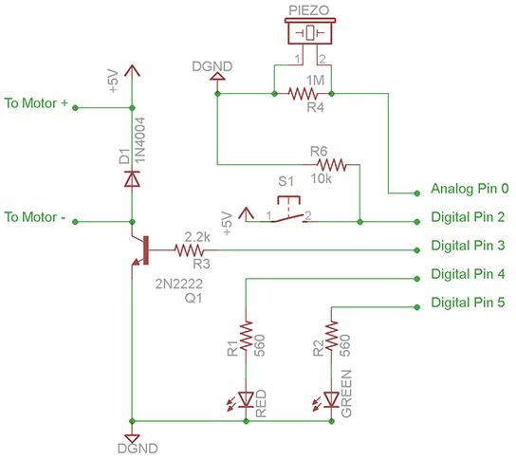

Slide 5
Objectives meeting outcome
The following objectives has been accomplished by our working prototype
As we mentioned before our objectives were as follows
The objective of this project is to secure the home with advancement features of a door lock.
Two way authentication makes the house more secure by preventing trespassers and even from thieves.
This smart door lock gives a firmness to your domicile.
Mostly one key is used for one door so when many users use door problems may occurs. And also security problems may occur if the keys can be duplicated. If the key is lost door can't be opened by the user and it can be found by someone else.

Slide 6
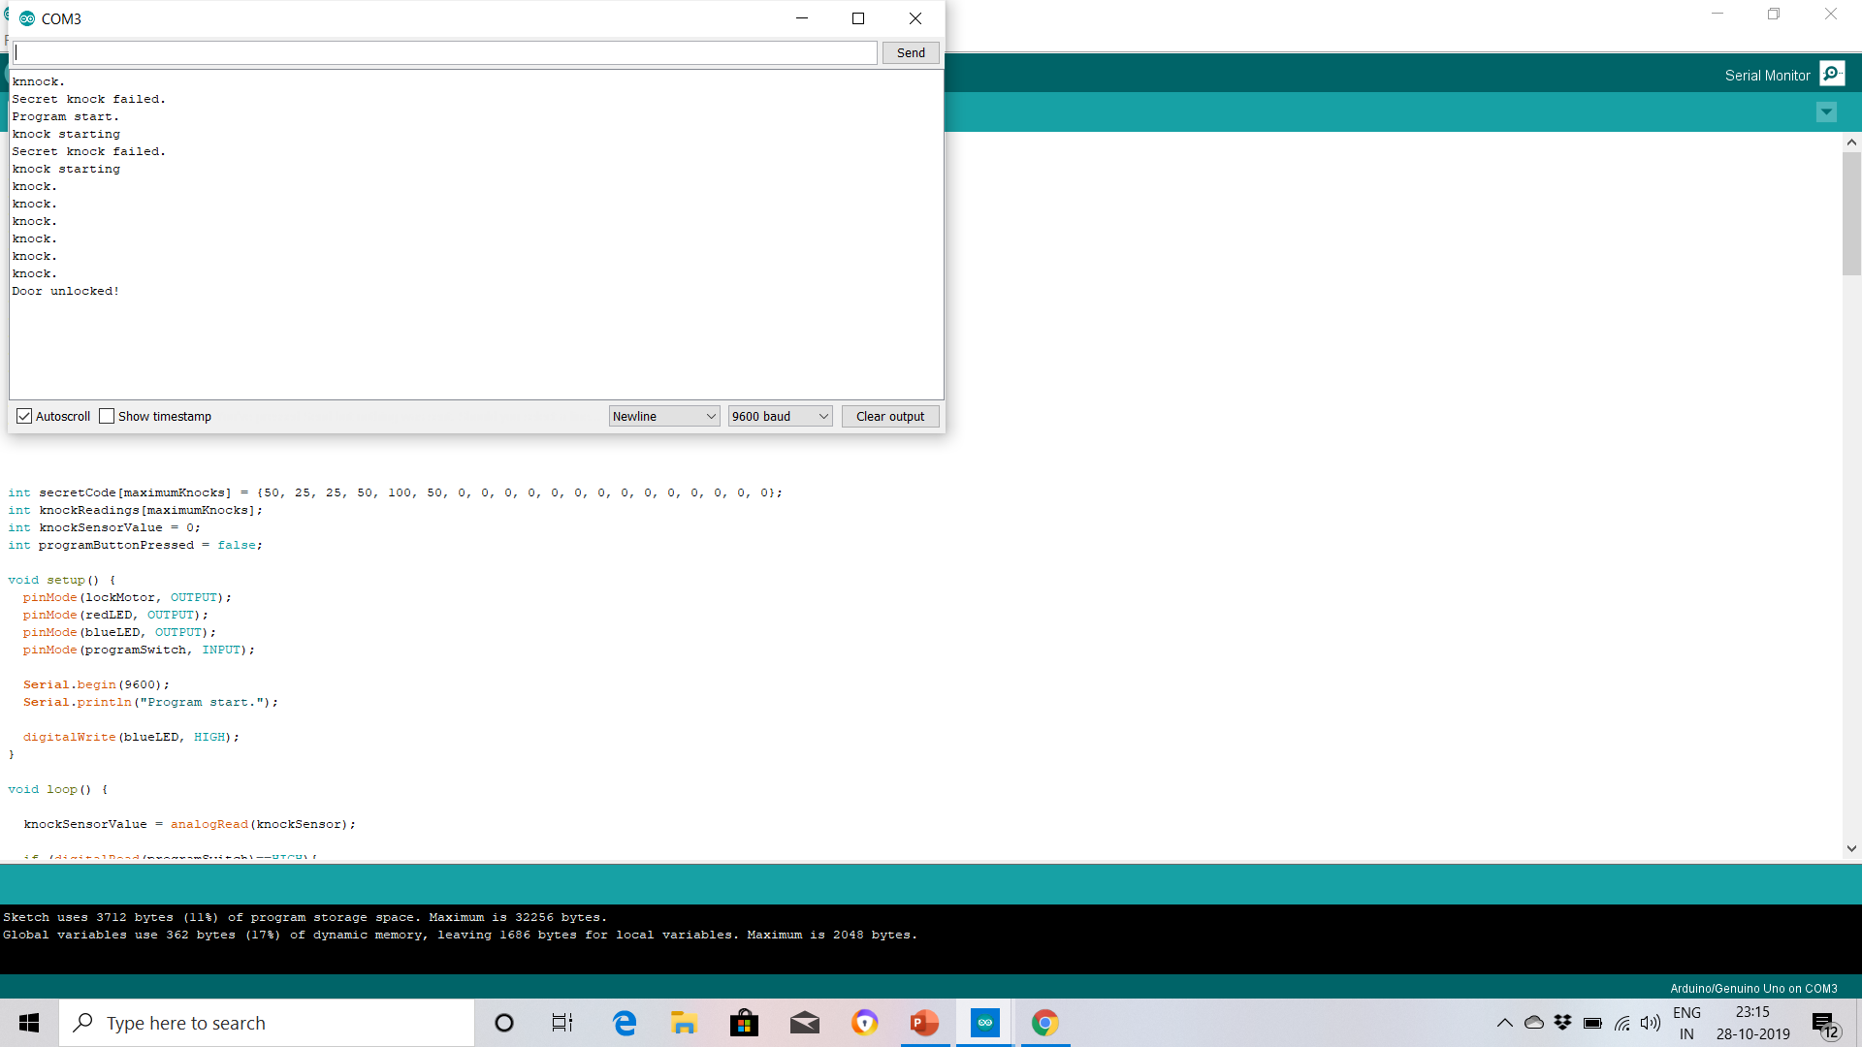
Results with Screenshots

Slide 7
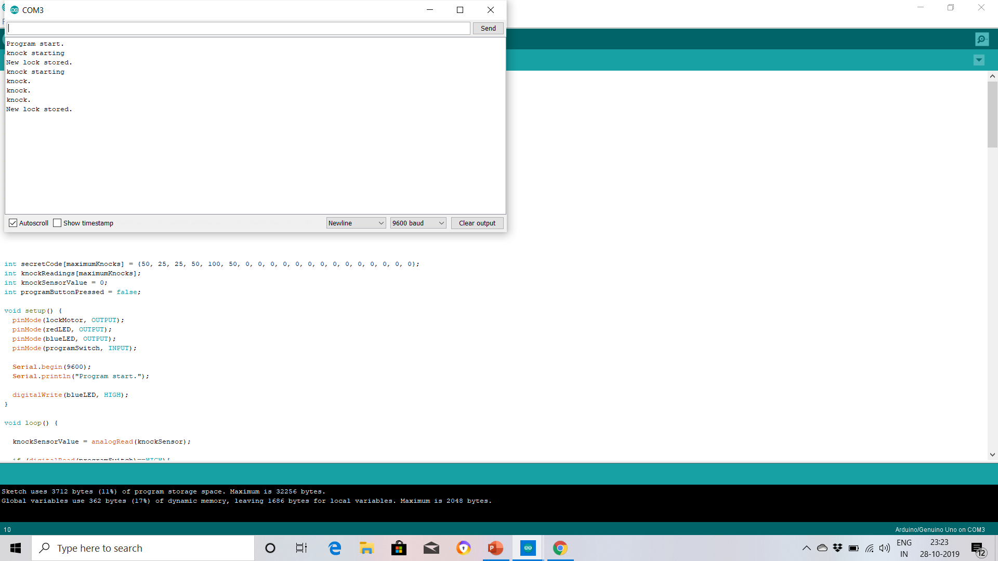

Slide 8
Future improvements can be made
For an improved effective system to be implemented and achieved the following suggestion should be considered for further work
A better sensor is recommended to achieve a better performance, enhance accuracy and achieve new functionality.
To achieve full automation a real time system should be employed and a closed circuit television CCTV system provided for proper monitoring and security purposes.
The system can be later enhanced by integrating counter mechanism or arrangement for keeping a record of entry and exit of guests and trespassers.

Slide 9

References
1.http:// www.arduino.cc/en/guide/Arduionmega2560
2.http://playground.arduino.cc
3.http://learn .adafruit.com /category/learn-Arduino
4.Sams Teach Yourself “Arduino Programming” by Richard Blum, Education 2015.
5.Project hub.

